Slide 1
Reproducible Workflows in R on a High-Performance Compute (HPC) environment
Gabriel Rosenfeld, PhD
Data Scientist
Bioinformatics and Computational Biosciences Branch

Slide 2
Bioinformatics and Computational Biosciences Branch (BCBB)
My background: Data Scientist in the Bioinformatics and Computational Biosciences Branch in the Office of Cyber Infrastructure and Computational Biology
Check us out: https://bioinformatics.niaid.nih.gov/researchcollaborationandsupport
Do you conduct research involving genomics (clinical, meta and microbial), imaging, data science and biostatistics, or structural biology?
We offer collaboration opportunities to address research questions at no direct cost to the NIAID research community and collaborators

Slide 3
Why learn reproducible workflows in R on HPC?
More efficient once the workflow approach has been mastered:
Leave a project and pick it up months later
Reproduce current results
Skip previous steps and concentrate on current parts of the analysis
Do it at scale (big data, complex processing)
Reproducibility crisis: it’s hard to reproduce and replicate many biomedical studies (Replication crisis – Wikipedia)
While not guaranteeing replicability, ensures reproducibility on the specific study/data pipeline used

Slide 4
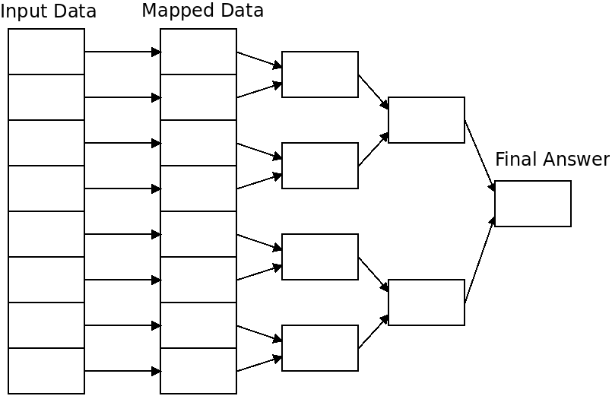
Embarrassingly parallel (or pleasantly parallel depending if you are a glass half full sort of person ☺ )
Suitable for a map-reduce approach
Large number of divisible parts of the analysis – often the case in data science
Finlayson, I. (2022). Parallel Algorithms. Retrieved 21 July 2022, from https://ianfinlayson.net/class/cpsc425/notes/22-algorithms

Slide 5
What is a reproducible workflow in R?
Reproducible workflow may have a nebulous meaning depending upon the R user defining it:
Is it an R markdown document with all the analysis steps in literate programming workflow?
Is it a set of scripts that can be run sequentially via an IDE or command line?
Is it a project folder with a readme, scripts, associated data?
For today’s tutorial, I define a reproducible workflow as a set of computational steps with associated code and data that can be run reproducibly by two different users to achieve an identical result

Slide 6
How does one use reproducible workflows in R?
Lots of potential options…CRAN Task View: Reproducible Research (r-project.org)
I recommend the targets R package, which focuses on “Make”-like declarative workflows (we’ll use it today):
R and functional programming focused
Works well with projects: typical of biomedical research
Data analysis recipe and dependencies (from “Make”)

Slide 7
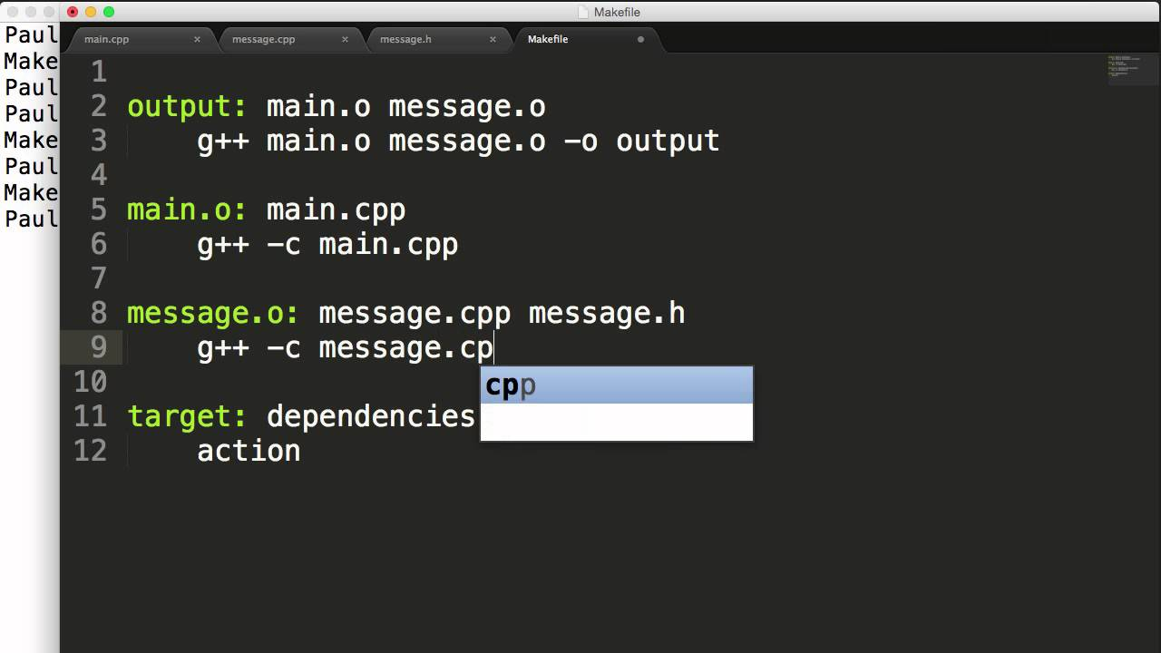
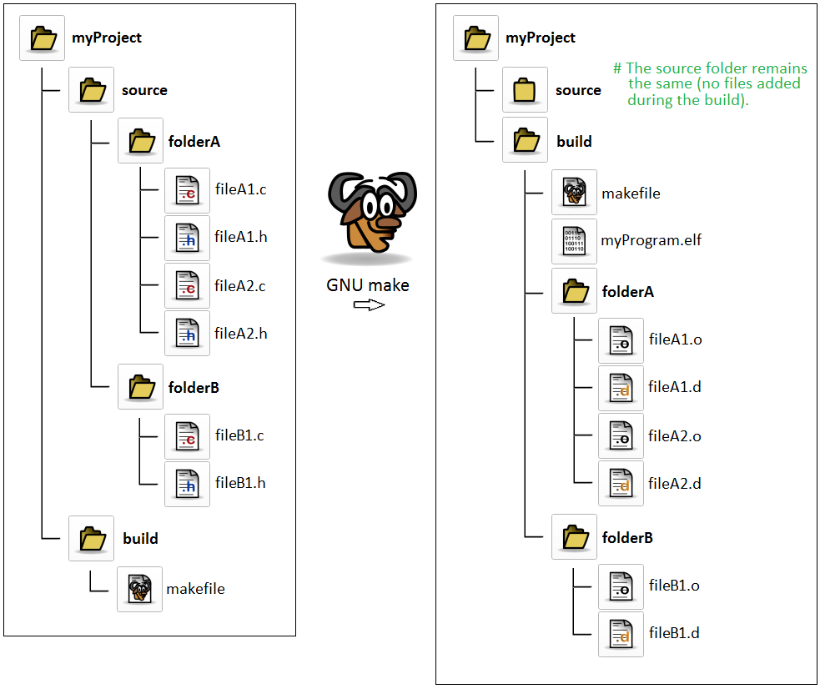
What is Make?
https://www.youtube.com/watch?v=_r7i5X0rXJk&ab_channel=PaulProgramming
Make is a program that takes an input called a “Makefile” that is a recipe for how to work with a series of executables and other files of a computer program. It keeps track of dependencies and only runs steps that need to be rerun during the compiling of the program.
https://www.gnu.org/software/make/
https://stackoverflow.com/questions/39015453/building-c-program-out-of-source-tree-with-gnu-make

Slide 8
What is targets?
An R package to allow an R analyst to maintain a reproducible workflow for a specific analysis they are working on:
Incorporates recipe concept with _targets.R file containing steps in the recipe of the data analysis
Interprets recipe to determine the order of steps (e.g., data loading, processing, visualizations, etc.)
Reruns only the necessary steps of the analysis (e.g., if working on visualization, then only visualization steps are rerun)
Developed by Will Landau, an Eli Lilly scientist, after seeing a need for an R package but not finding one with all required features
https://docs.ropensci.org/targets/

Slide 9
Specific features of targets R package
Part of a suite of R packages that is evolving to handle common analysis tasks (e.g., ML, AI, Bayesian, etc.): (https://wlandau.github.io/targetopia/packages.html)
Extremely helpful documentation and examples to get started (https://books.ropensci.org/targets/)
Functional programming style (e.g., a certain analytic step is incorporated into a function and then return results for use in subsequent steps which are also functions)
Useful debugging to identify errors or other issues (https://books.ropensci.org/targets/debugging.html)
Well-suited for project-based analysis and structure
Set up to allow analysis to scale:
Static and dynamic branching execute a common function (e.g., a model) across data subsets (https://books.ropensci.org/targets/dynamic.html)
Support for high-performance computing (https://books.ropensci.org/targets/hpc.html) ** This will be our focus today
Facilitates collaboration when used with other data scientists and tools like code versioning

Slide 10
Targets project setup with tflow and renv
Targets has a whole chapter on how to use it within projects (https://books.ropensci.org/targets/projects.html)
I recommend tflow (https://github.com/MilesMcBain/tflow) and we’ll use today to set up the project
I also recommend renv to set up a project library (https://rstudio.github.io/renv/articles/renv.html)
Benefits of tflow:
GitHub install with dependencies installs targets and other key R packages
Functions that can set up a consistent project structure
fnmate to quickly add new functions to represent each step in your analysis as R files
conflicted to detect conflicts between packages
Updates project environment to prevent unintended use of logical vectors

Slide 11
High Performance Compute (HPC) interface with targets
Targets works with HPC via intermediary R packages that schedule different parts of workflow to the HPC scheduler
clustermq: https://github.com/mschubert/clustermq
future: https://future.futureverse.org/ - what we’ll use today
Cloud (e.g. AWS) is not currently supported but is in dev

Slide 12
Using targets with future on the HPC
Needs additional R packages (https://www.futureverse.org/):
future: uniform way of translating the R code to the asynchronous processing method
future.batchtools: batchtools interface to HPC types such as LSF, OpenLava, UGE, Slurm and TORQUE
Of course, one needs access to an HPC as well ☺

Slide 13
Where to find R and RStudio if you want to use targets for your analysis on HPC?
Within NIAID, the LOCUS HPC cluster: https://inside.niaid.nih.gov/media/locus-high-performance-computing-hpc-support-portal
Within NIH, you can use the Biowulf HPC cluster: https://hpc.nih.gov/
Uses another scheduler so will need to find a suitable template file for batchtools to work here

Slide 14
Tutorial overview
I will provide a tutorial of using targets for reproducible workflows on the NIAID Locus HPC during the next part of the webinar
Next part of presentation covers the pre-requisites and set-up if you would like to follow along
I will keep the tutorial moving at a steady pace, so we complete it
If you only want to listen or if you get stuck, no worries…
You can go back to the material and complete later
Goal today is to introduce the material and demonstrate its use

Slide 15
Tutorial overview
Our goal today will be to show how to set up a workflow to run a deep learning AI model to predict a diagnosis of heart disease (https://tensorflow.rstudio.com/reference/tfdatasets/hearts/)
We modify a general tutorial for the workflow (https://tensorflow.rstudio.com/tutorials/advanced/structured/classify/)
Key objectives:
Create a targets workflow project on NIAID Locus leveraging available resources (e.g., request GPU node for the AI training)
Setting up a project specific conda environment with TensorFlow and other required software
Downloading, wrangling and modeling the data

Slide 16
Pre-requisites for tutorial
You will need access to NIAID Locus with NoMachine set up for interactive sessions:
Locus User Portal (nih.gov)
Downloaded course materials (more details later)
There are also detailed instructions in the .Rmd file for the initial required software and set up in the reproducible_workflows_hpc course within the course materials

Slide 17
Tutorial Set Up
Log in to NIAID Locus via NoMachine
Start a terminal and execute following code to start up an interactive session (and type yes):
qrsh -l h_vmem=8G -pe threaded 4
Load R and RStudio module by executing following code in the terminal interactive session:
module load rstudio/1.4.1717-R-4.1.0
Launch interactive RStudio session by executing following code in the terminal interactive session:
rstudio &
Click on Activities on top left of desktop and open Mozilla Firefox
In Firefox, navigate to the public repository for the course (https://github.com/niaid/Data-Science-with-R) to download the course materials (details on downloading on next slide)

Slide 18
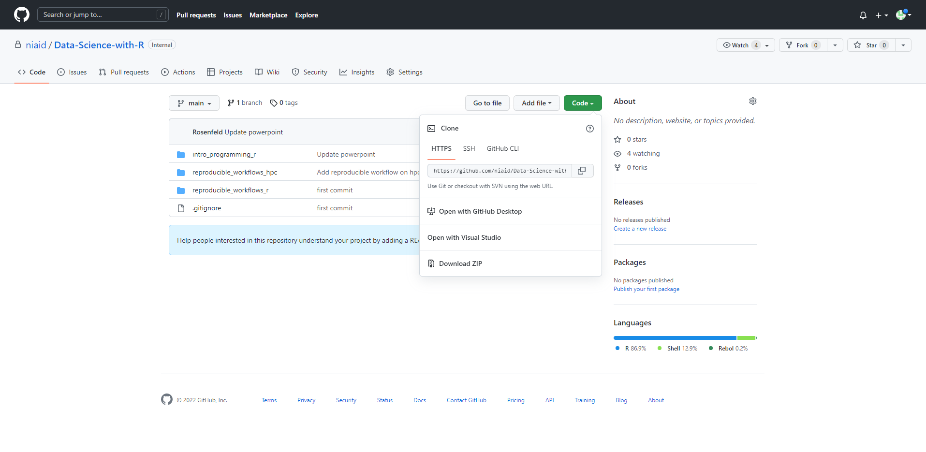
Tutorial Set Up
https://github.com/niaid/Data-Science-with-R

Slide 19
Tutorial Set Up
Open the Files app on the Activities tab and navigate to the Downloads folder
Copy the zipped folder to your /hpcdata/lab/user directory (so as not to exceed memory in your home folder as conda environment is ~5gb)
Unzip the downloaded file in your user data directory (Open With Archive Manager and extract)
Go back to interactive RStudio tab and open project
Under File click open file
Navigate to your user folder and Downloads folder
Open Data-Science-with-R-main then reproducible_workflows_hpc folder
Open reproducible_workflows_hpc.Rproj

Slide 20
Tutorial Set Up
In RStudio, set up the project library with renv
Add the following code to the console and hit enter after each:
renv::restore()
Write “y” to any prompts
We will try running the pipeline from scratch requesting up to four available processes on LOCUS
Execute the sub-bulleted code below in Rstudio console
First let’s see what steps are outdated:
targets::tar_outdated()
Next let’s refresh the pipeline… may take time especially conda environment set up! Also, we will simultaneously be using resources.:
targets::tar_make_future(workers = 4)

